Slide 1
a

Slide 2
cat

Slide 3
mat

Slide 4
rat

Slide 5
sat

Slide 6
hat

Slide 7
pat

Slide 8
tap

Slide 9
cap

Slide 10
am

Slide 11
Sam

Slide 12
Pam

Slide 13
ham

Slide 14
ram

Slide 15
an

Slide 16
can

Slide 17
tan

Slide 18
jump

Slide 19
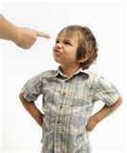
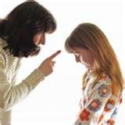
not

Slide 20
up

Slide 21
down

